Slide 1
Hiring & Maintaining Credentialing Talent
Certification Networking Group
Washington DC
June 14, 2017

Slide 2
Rory McCorkle Dania Eter
Jennifer Naughton
Connect with us on LinkedIn!

Slide 3
Introduction
We are entering the new age of the employee. The demand for talent has reached unpresented levels.
Employers scramble to fill their open positions with skilled personnel.
Effective talent management is critical for any organization, and particularly in a field with specialized skills like credentialing.

Slide 4
Introduction
What are your greatest challenges and the strategies to address them?
Today we will learn from success stories provided by you and your industry colleagues.

Slide 5
Goals
After attending this session, you will be able to:
Identify the top talent challenges facing the industry
Identify three core areas that your talent strategy must consider
Systematize development of your in-house talent
Start creating an action plan to close those credentialing talent gaps today!

Slide 6
Agenda / Flow
Part 1 – The Landscape & Your Pain Points – 10-15m (Jennifer)
Part 2 - Tools/ Strategies for Building Staff – 10m (Rory)
Part 3 - Facilitated Discussion of Challenges/Tips – 45m (All)
Part 4 – Wrap Up – 5m (Jennifer)

Slide 7
Part 1: The Landscape
Based on approximately 1500 responses in May 2015
43% of organizations reported staff of 5 or fewer FTEs; median 7 FTE staff
34% have 6-20 FTEs
24% have more than 20 FTEs
Psychometrics is the most frequently outsourced function at 87%, test administrator at 86%, item writing at 44%
Most common credentialing positions are manager, director, customer service representative, and specialist
Source: ICE Certification Industry Compensation & Benefits study of the certification industry, 2015

Slide 8
The Landscape
Credentialing is a niche industry with highly specialized skills; shortage of qualified people to fill them on day 1
Supply is especially scarce at the specialists and the manager level; open positions appear to be limited at the director level
Average tenure of an FTE employee is much shorter than in the past; retention will continue to be a challenge in the future

Slide 9
“Two-thirds of Millennials express a desire to leave their organizations by 2020. Businesses must adjust how they nurture loyalty among Millennials or risk losing a large percentage of their workforces.”
The Landscape
The Deloitte Millennial Survey Winning over the next generation of leader

Slide 10
Audience Participation Politely Encouraged
What are YOUR pain points?

Slide 11
What is the solution?
We need to be innovative and smart when it comes to the core areas associated with an effective talent management strategy:
attracting talent (acquiring talent)
developing talent (building skills)
retaining talent (keeping people around)

Slide 12
Part 2: Strategies for Building Credentialing Staff
Acquire/Hire
Hire complementary skillsets
Vertical promotion
Internal hire

Slide 13
Hiring Strategy

Slide 14
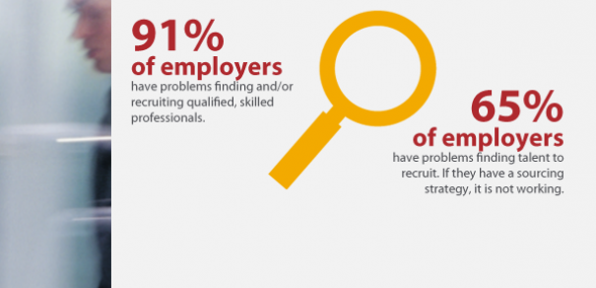
Hiring Strategy

Slide 15
Acquire Strategy
Pros – you get someone who fits all of your requirements
Cons – more expensive, lower success / retention rates, limited talent pool
18-20%
Premium paid for an external hire
57%
Proportion of individuals that took 6+ months to reach full impact

Slide 16
Hire Complementary Skill Sets
This strategy looks at hiring individuals who have a background in education, product management, or other companionate sectors
This strategy is used increasingly, due to limited experienced credentialing talent pool
Pros – outside perspective can provide fresh insights
Cons – same cons as the Acquire strategy, plus additional ramp-up time to learn the credentialing industry

Slide 17
Vertical Promotion
Infrequently used due to the small size of most organization’s teams
Pros – deeper familiarity with credentialing industry, organizational culture, familiarity with customer base
Cons – lack of fresh insight

Slide 18
Internal Hire
Where vertical promotion promotes existing credentialing staff, internal hiring look for talent from other departments
Pros – some familiarity with credentialing industry, organizational culture, familiarity with customer base
Cons – ramp-up time

Slide 19
Other Methods to Build Resources
Internship program
Cross-training program
Mentoring program

Slide 20
Career Pathing
Many organizations can benefit from career path maps that show how skills from one position internally may be transferred to another position
For example, how can a Customer Service Representative (CSR) move on in their career?

Slide 21
Career Path
CSR
Certification Coordinator
Test Development Associate
Continuing Education Coordinator

Slide 22
Career Path
Assistant or Administrator
Certification Manager
Test Developer
Product Owner

Slide 23
Part 3: Facilitated Discussion
What are some challenges you have encountered with respect to certification talent and what did you do to resolve it?
Attracting talent
Developing talent
Retaining talent

Slide 24
Part 3: Facilitated Discussion
What are some challenges you have encountered with respect to certification talent and what did you do to resolve it?
Attracting talent
Developing talent
Retaining talent

Slide 25
Part 3: Facilitated Discussion
What are some challenges you have encountered with respect to certification talent and what did you do to resolve it?
Attracting talent
Developing talent
Retaining talent

Slide 26
Part 4: Summary
Three keys to the strategy
Attracting talent
Developing talent
Retaining talent
Decide if You Want To Leverage a Buy or Build Approach
One Way to Systematically Build Internal Resources Is to Use a Career Pathing Tool
Consider Innovative Staffing Models

Slide 27
Summary: Attracting Talent
Competitive salaries/benefits
Temp to hire - test employee before full commitment; 30% of working market are free lance and the number is growing with Millennials
Hire for talent regardless of location
Small industry/ direct reach from other companies
Washington DC/Chicago vs. US
Clear and fast-paced growth path, particularly for Millennials
Internships and university outreach
Focus on functional skillsets (e.g., product management, Marcom) and using resources to teach certification (e.g., ICE)
Non-profit appeal / helping society at large, particularly for Millennials
Internal hiring

Slide 28
Summary: Developing Talent
Industry conferences & engagement as training tools
Local group engagements CNG, Chicago Testing Network Group
Job swap/Job Share/Project base involvements
Grown from within vs. New blood – Innovations? Agility?
Sr. Leadership and growth potential/ Is the market too small for everyone to grow? What is the ceiling?
As above, ICE resources and training materials (e.g., Cert 201, Certificate Program) or similar resources
Team gatherings and retreats as coaching and training tools
Mentoring programs – new employee ‘buddy’
Pairing employees – one skilled in functional area, one with Certification expertise for mutual training (think Paired Programming)

Slide 29
Summary: Retaining Talent
Based on need, hire as needed
Industry conferences & engagement as training tools
Local group engagements
Company strategy and visible growth potential vertically and horizontally
Consistent succession planning – expecting an employee to last more than three years is no longer viable
Willingness for inter-departmental hiring vs. old protectionism

Slide 30
Summary: Your Notes

Slide 31
Bonus Slides!

Slide 32
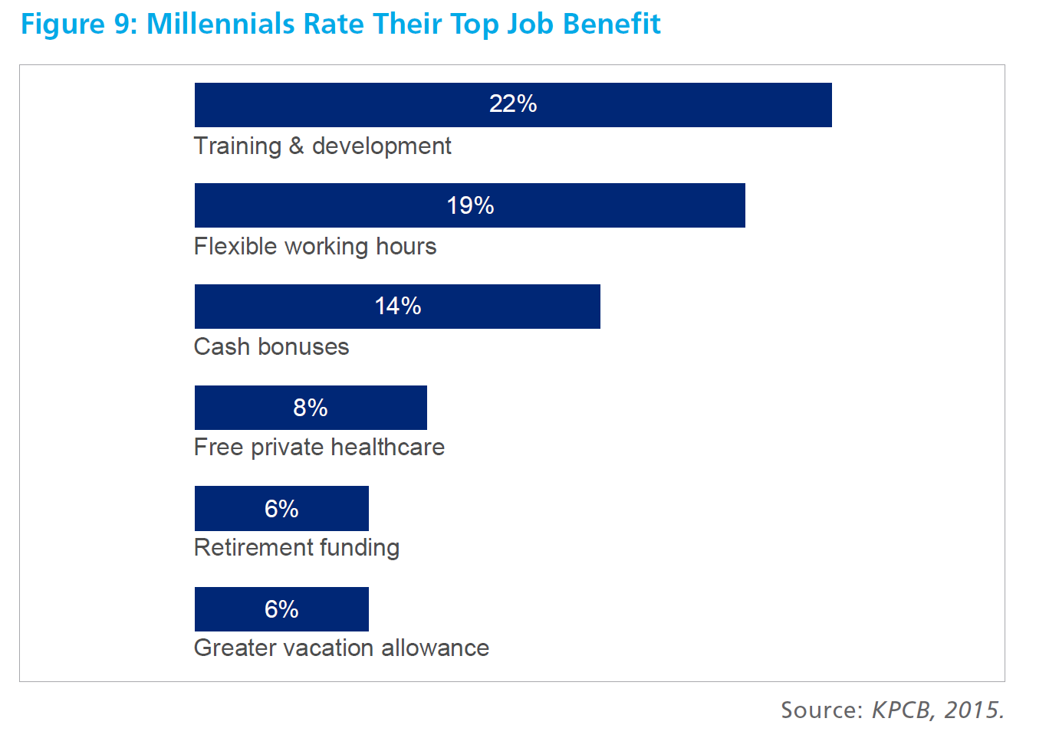
Perks
Source: Unknown

Slide 33
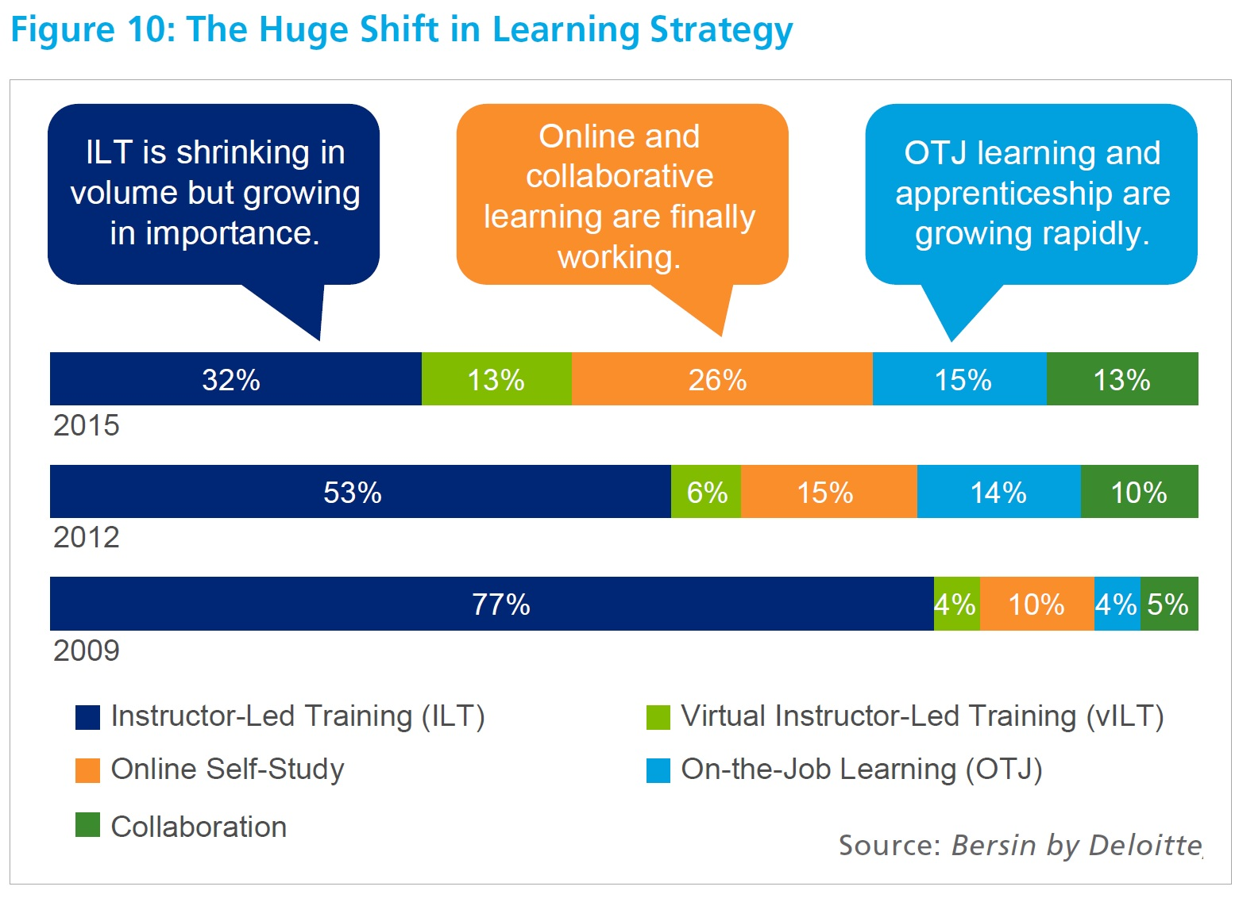
2
1
ILT & vILT 45%

Slide 34
Loyalty. What is one thing that would make you more devoted to your current employer? Flexible work options would make 82 percent of the survey's respondents more loyal. So what are flexible work options? This could mean working remotely, telecommuting some of the time, part-time or freelance work or an alternative work schedule. Loyalty makes for better employees who go above and beyond. Companies may not be able to put a price tag on loyalty, but they know it when they see it. It's a win-win for employees and employers.
Quality of life. What would positively impact your quality of life? Ninety-seven percent of study participants reported that a job with flexibility would do the trick. Working a job with a flexible work schedule would lower stress levels, according to 87 percent of respondents, and more than three-quarters of them believe it would make them more healthy.
Source: US News and World Report – three benefits of workplace flexibility

